Slide 1
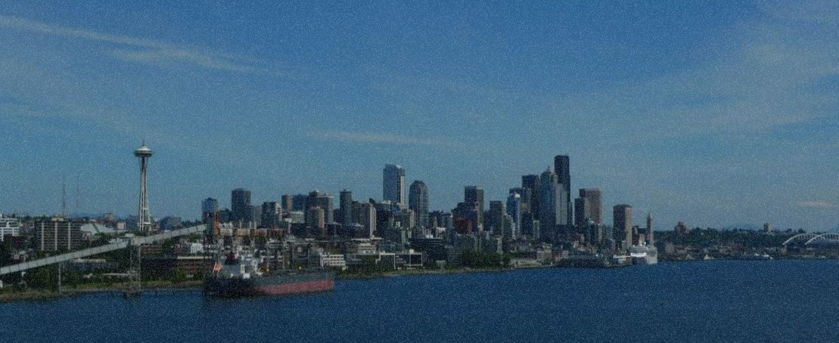
Seattle
Making the Most of Your First Port

Slide 2
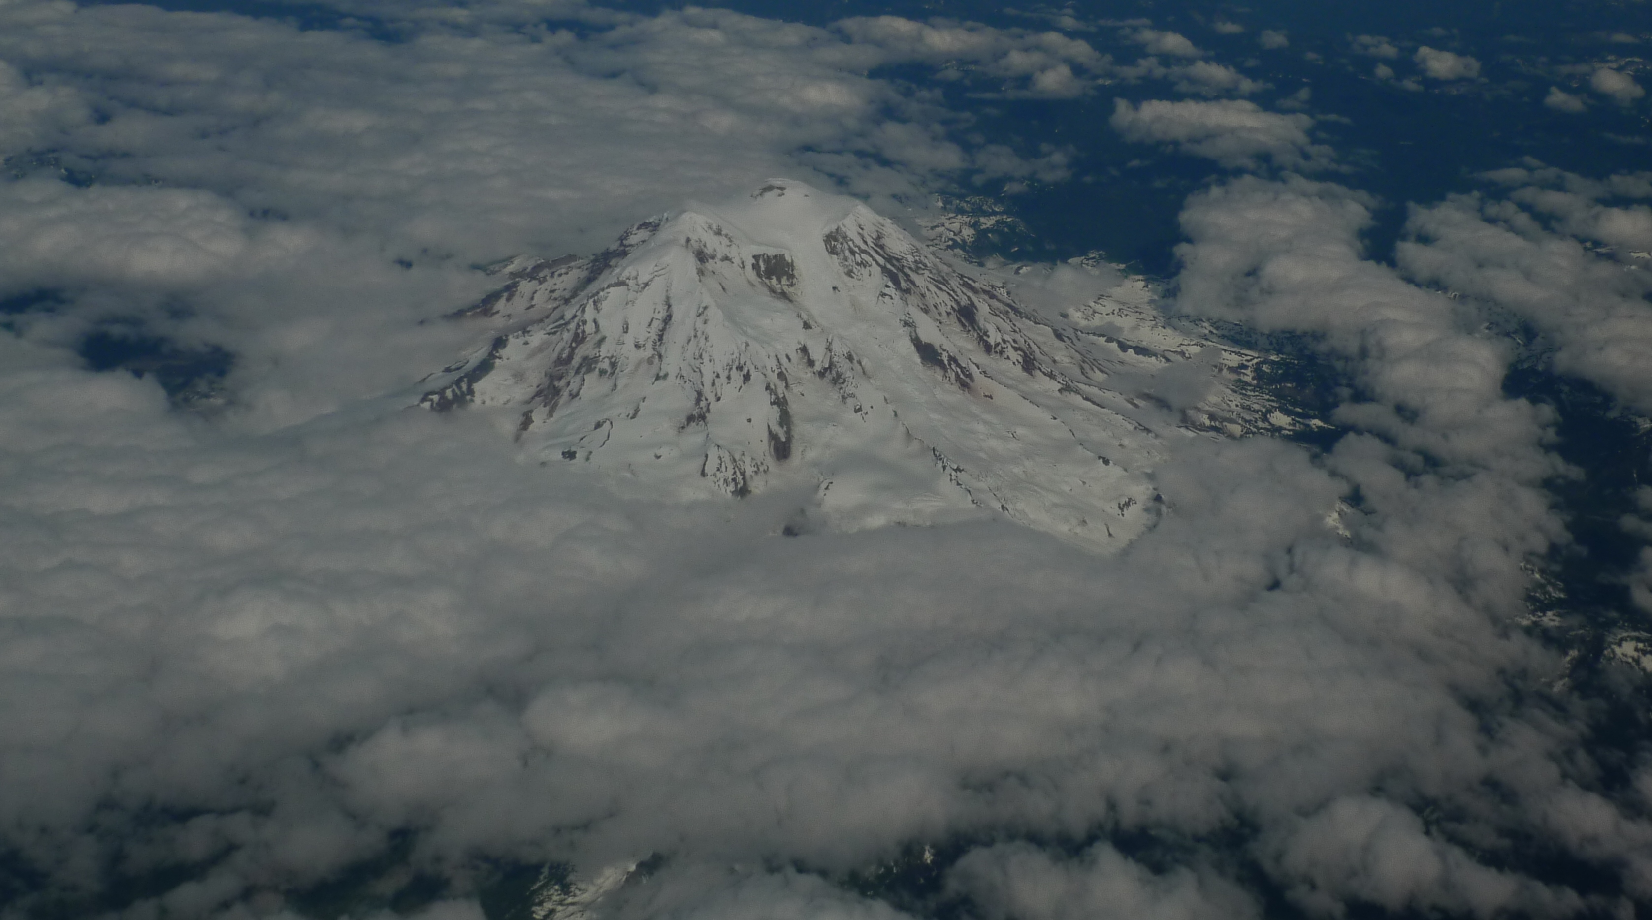
Visit Mt. Rainier National Park!

Slide 3
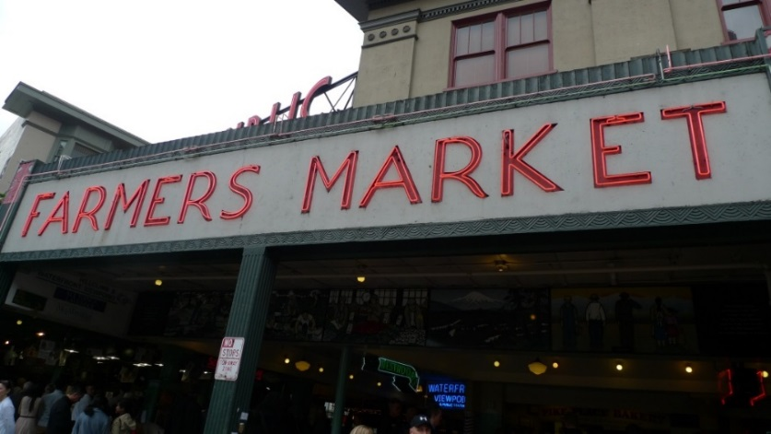
Day One Sample Itinerary
Get an early start!
Pike Market for breakfast and shopping
Olympic Sculpture Park and a stroll along the waterfront
Mid-afternoon
The Seattle Aquarium
Evening
Seattle Underground Tour

Slide 4
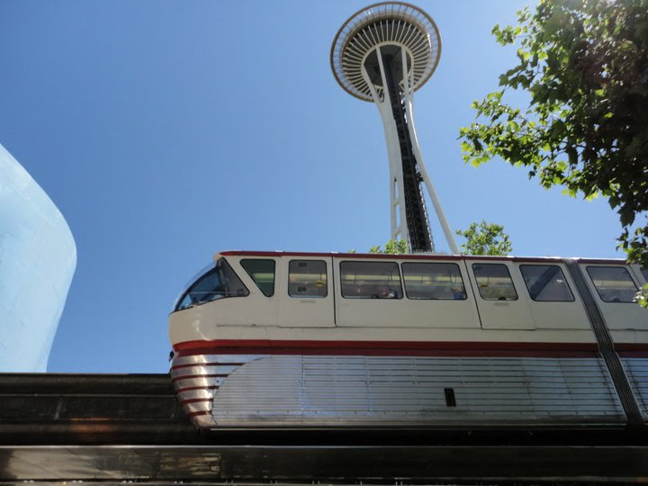
Day Two Sample Itinerary
Pike Market
Breakfast here again and visit the places you loved or missed
Experience Music Project and Science Fiction Museum
The Space Needle
Seattle’s iconic and most famous landmark

